Slide 1
Exploratory Data Analysis
Udemy Data-Set

Slide 2
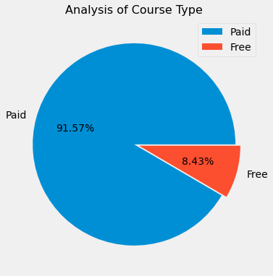
Paid vs. Free Courses
Most of the offered courses are paid.
Only 8.43% are Free Courses.
Authors prefer to get paid for the courses due to the time and resources they had invested.

Slide 3
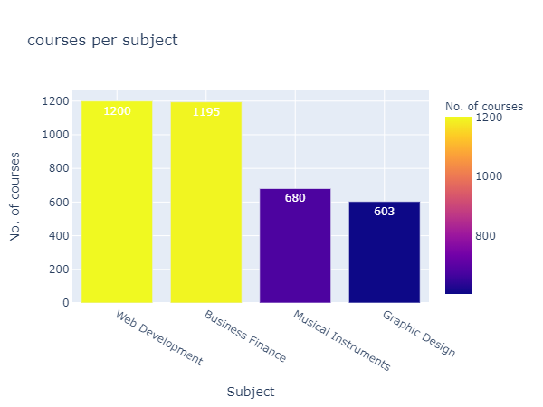
Subject analysis
High Concentration of Web Development and Business Finance courses
Least amount courses are under the Graphic Design.

Slide 4
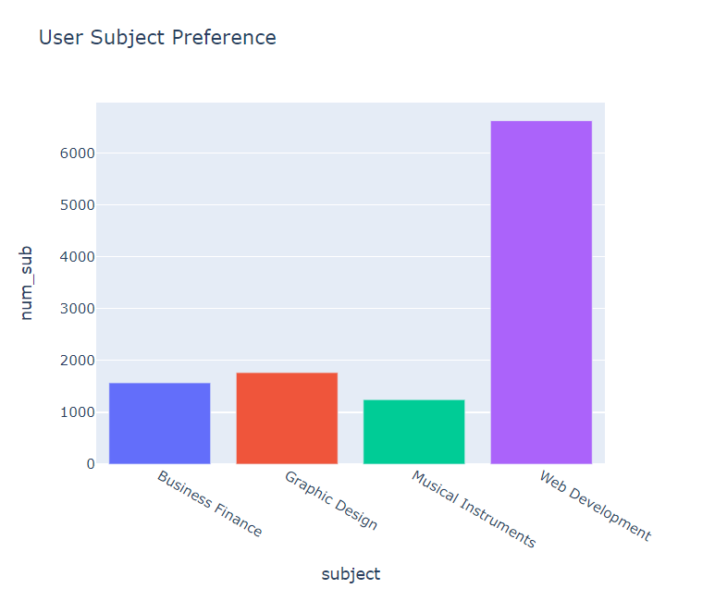
Users have a High subject preference towards Web Development
Graphic Design is the 2nd most Popular Courses followed by Business Finance

Slide 5
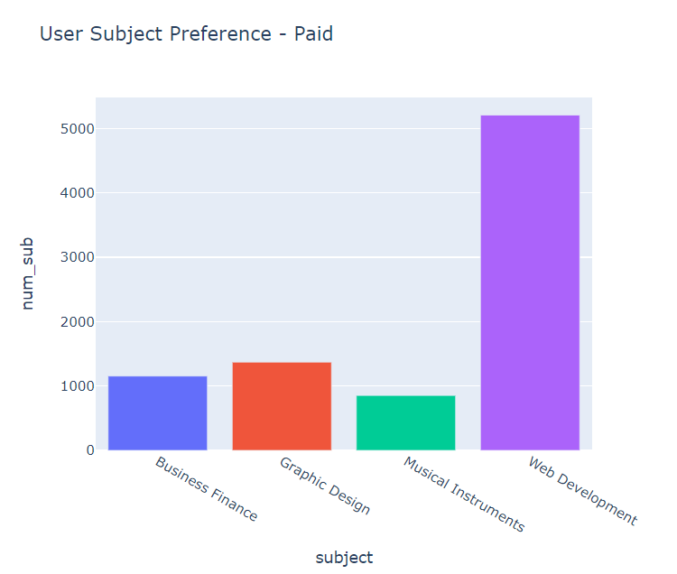
The general trend is same in the Paid category

Slide 6
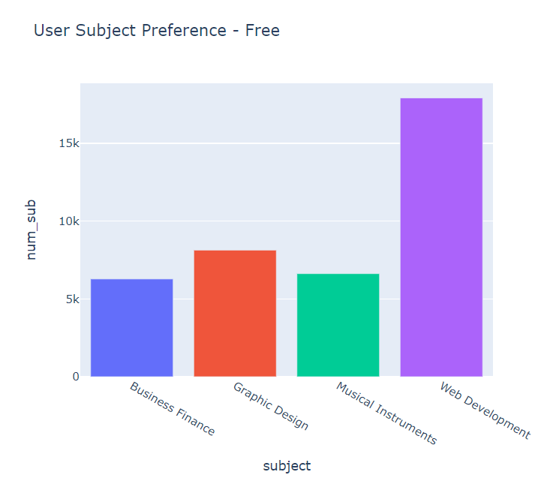
Musical Instruments courses have a higher user preference when they are offered for free.
Musical Instruments have higher preference than Business Finance when it offered for free

Slide 7
Subject analysis
Users Have High Preference for Web Development
Increasing more courses on Graphic Design would be profitable because of user preference
Despite Business Finance having a high concentration of courses. It is the 2nd least preferred subject by users.

Slide 8
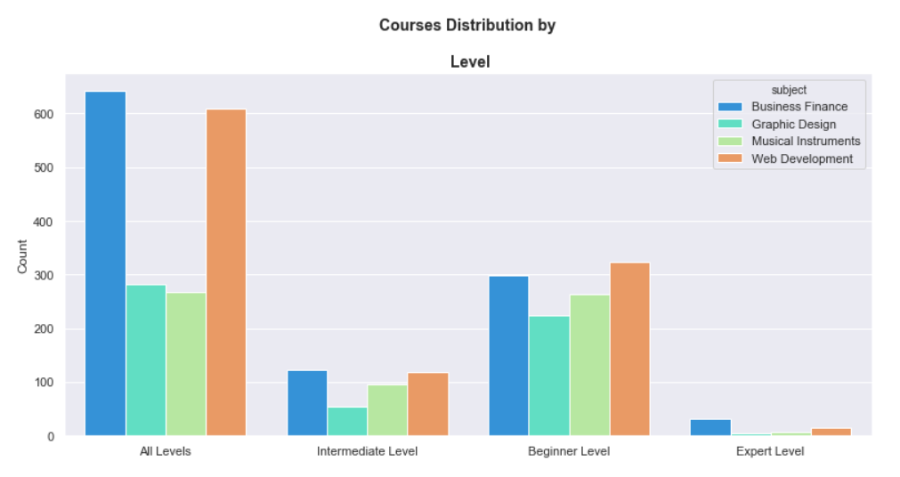

Slide 9



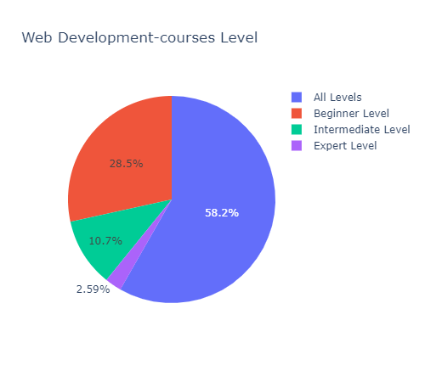
The offered courses are mostly paid courses with less free courses among all the subjects.
Among all the subjects, many courses are for all levels followed by beginner level, Intermediate level and expert level. Very few expert level courses are offered in all the subjects

Slide 10
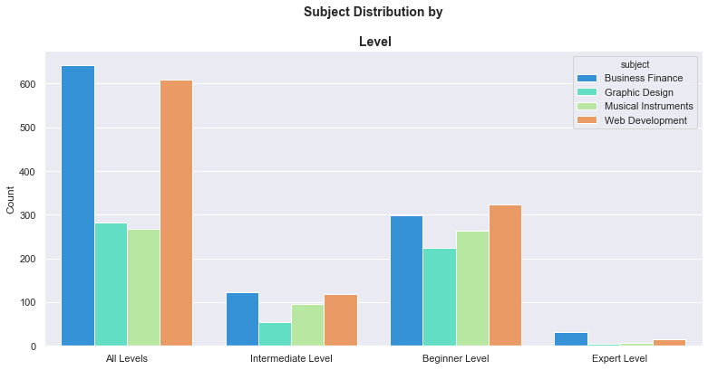
Levels vs. Subjects (Courses)
Regardless of the Subject there is high concentration on All level and Beginner level courses.
Graphic Design has slightly preference being an all level category.
Low concentration of Expert Level Courses compared to the Beginner and All Level courses .

Slide 11
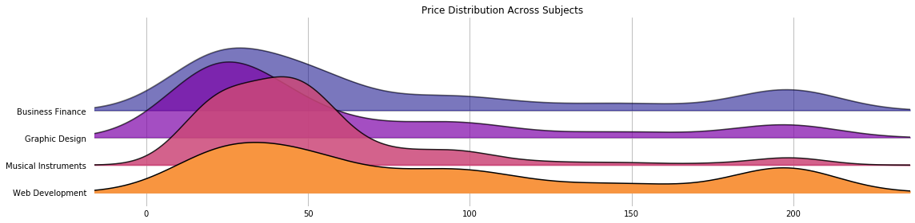
Course-Price by subject Distribution
High concentration in low cost courses(excluding free).
Courses in higher price category like in case of ‘Web Development’ and Business Finance have significant subscribers. This shows positive signs that users are willing to spend money for high price courses as well.
Musical Instrument courses have high concentration on low cost courses.

Slide 12
Level Analysis

Slide 13
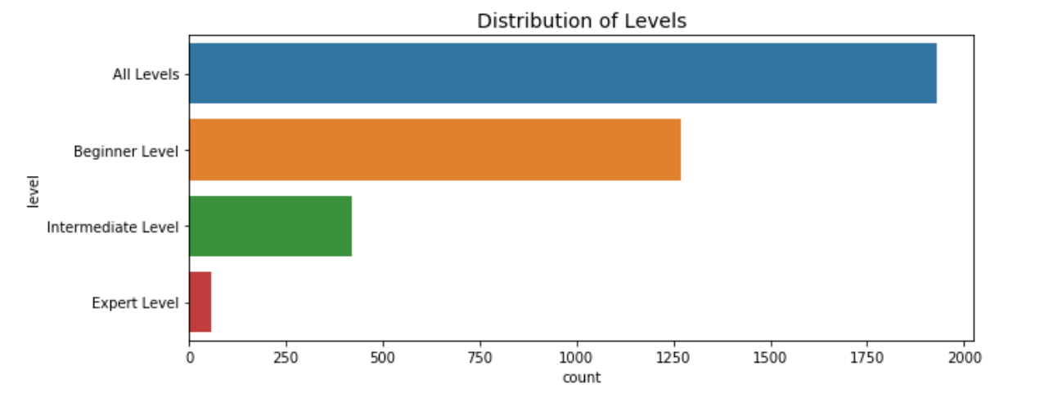
Level Analysis (Courses)
Four levels:
Beginner level
Intermediate level
Expert level
All levels
High Concentration on “All levels “ Category in courses followed by beginner level.
Every low amount of courses on Expert Level.

Slide 14
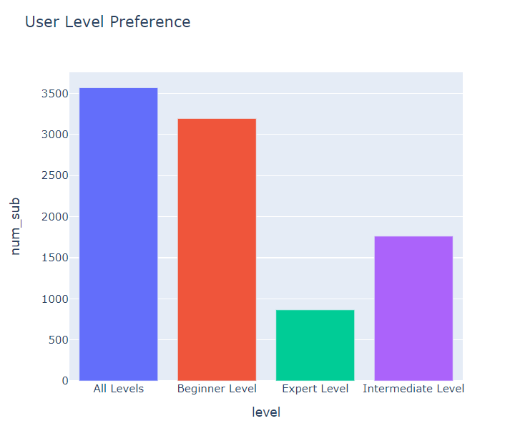
Users prefer Levels to ‘All Level’ or Beginner more.
Very Less users prefer Expert Level.

Slide 15
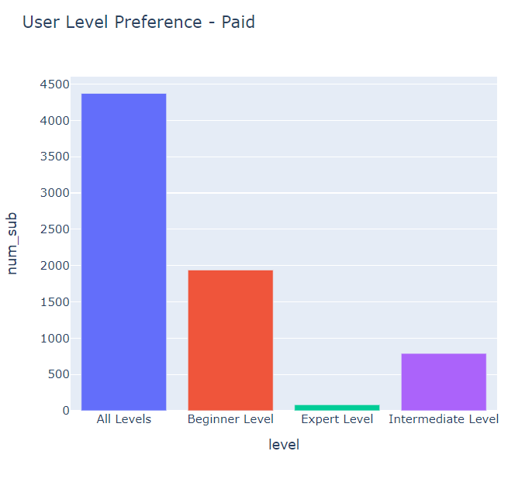
The trend is similar to the general user preference

Slide 16
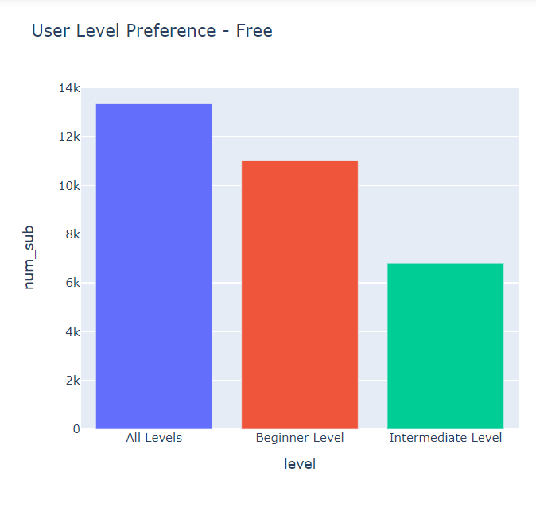
The Number of subscribers are more when the courses are offered for free
Expert level courses are available for free

Slide 17
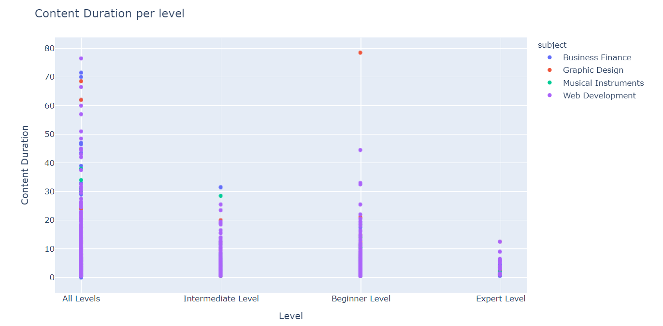
Expect the All level Category. Courses generally prefer to have Less content Duration.

Slide 18
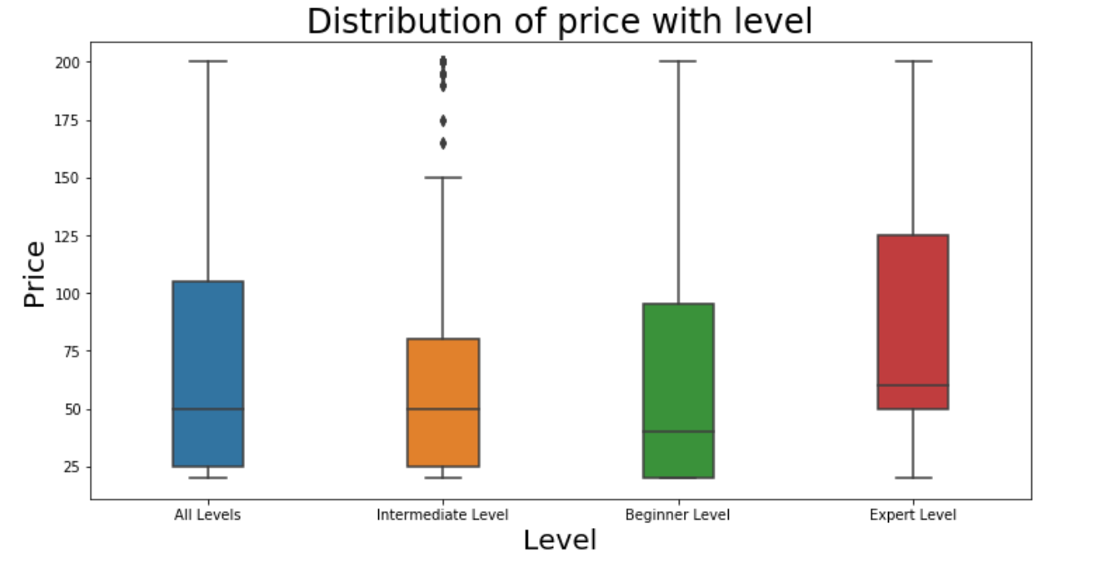
(paid courses alone)
Price of courses with expert level is starting from a very high rate as compare to the price of other level courses .
Price of the beginner level courses is very less that most of the students can afford

Slide 19
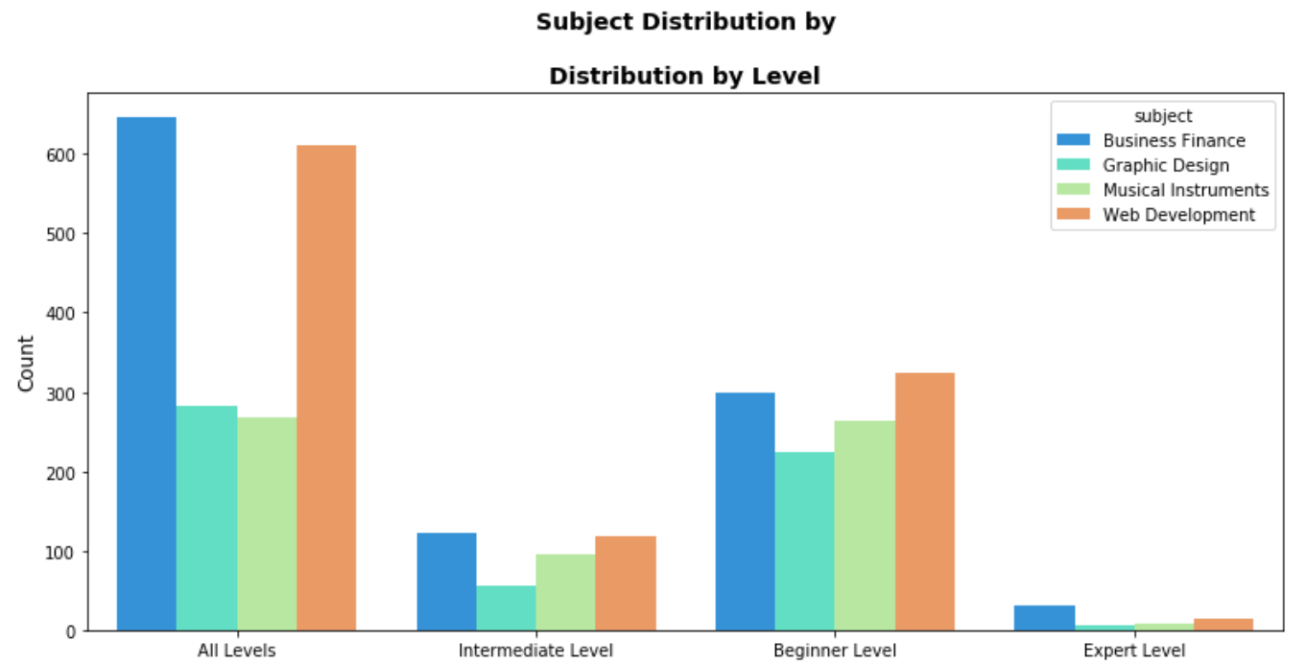
***FOR PAID COURSES.
In paid courses Web Development Business Finance have equal concentration.
Business Finance has more course concentration on Expert level .

Slide 20
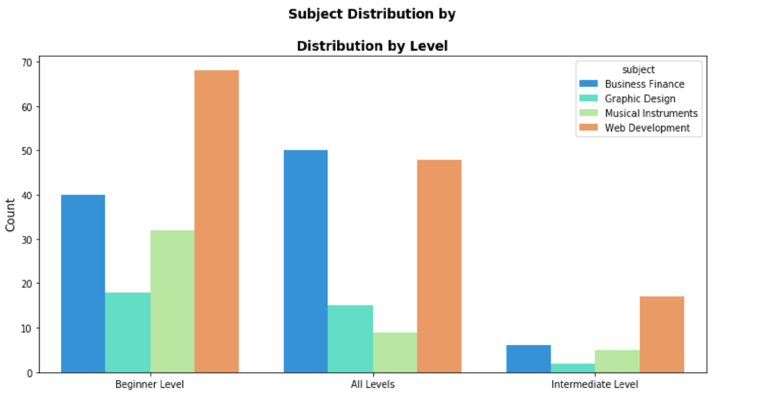
***FOR FREE COURSES
Among Free courses web development has High Concentration
Business Finance has slightly higher concentration on ‘All levels’ category.

Slide 21
Price
Initial Observations:
The price of the courses varied from 0 to 200 dollars.
There are courses with zero subscribers
Number of reviews are way lesser than the subscribers.

Slide 22
Observations
Initial Observations
Most of the offered courses are paid.
Only 8.43% are Free Courses.
Most of the offered courses are for All levels followed by Beginner level and Intermediate level. Only 1.58% of the offered courses are advanced level.

Slide 23
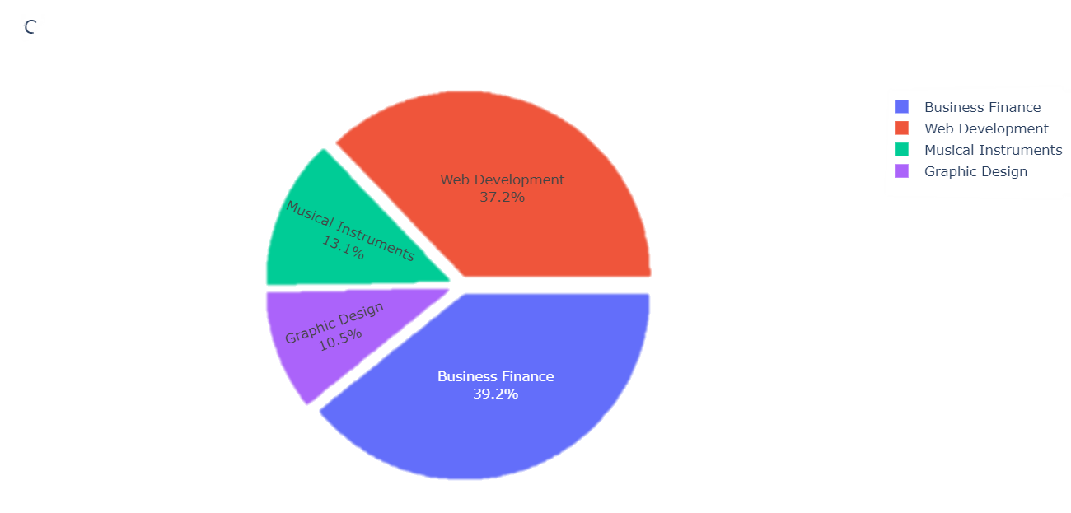

Slide 24
Most of the Courses are in the price range of 20 to 50 units per course.
There are a few courses which are free and a few courses with a high price tag of 200 units per course.
Most of the courses below 50 dollars.

Slide 25
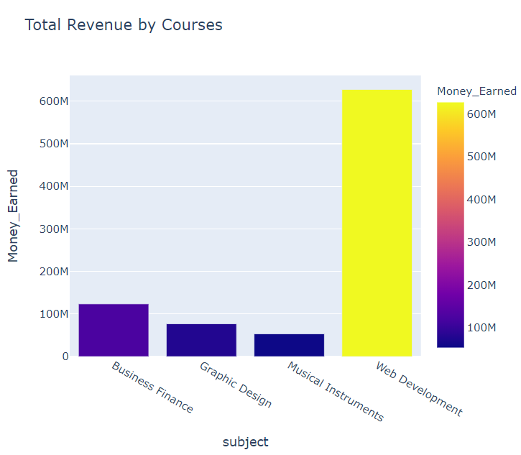

Slide 26
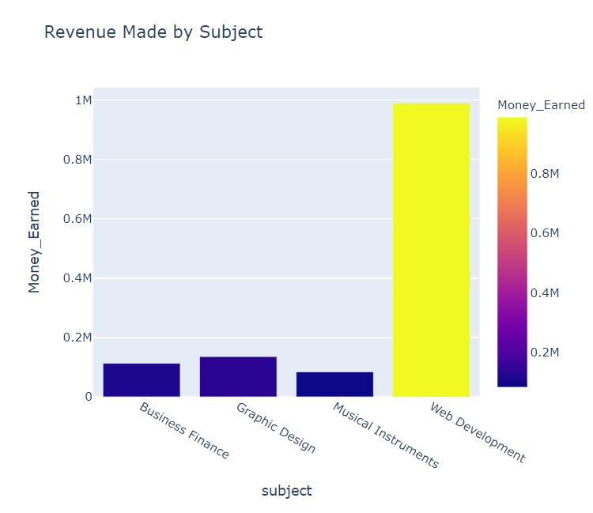

Slide 27
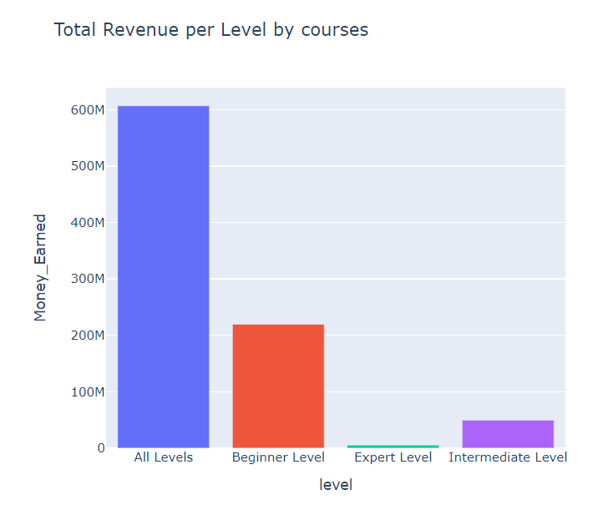

Slide 28
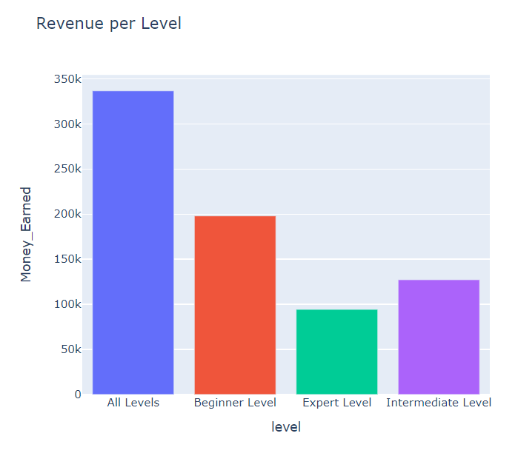

Slide 29
The Number of Subscribers are relational to the number of reviews for the unpaid courses where as number of reviews are more for paid courses and number of subscribers are less

Slide 30
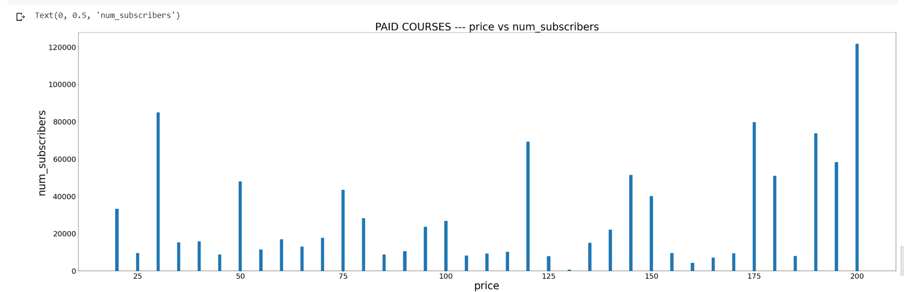
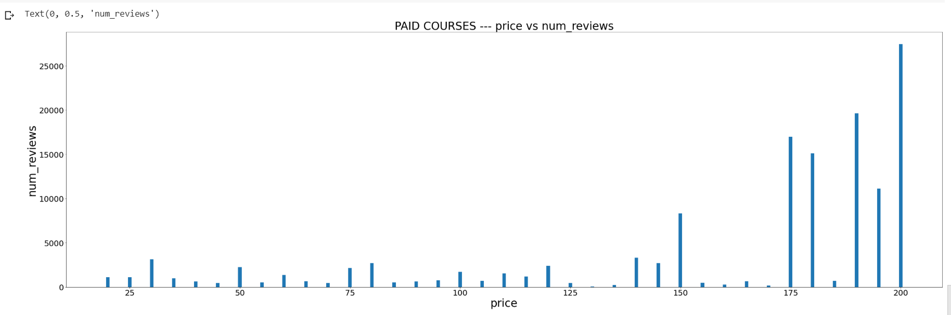
DATA INSIGTHS ON PRICE
The highest number of subscribers are for the highest course price.
The highest number of reviews are for the highest course price.

Slide 31
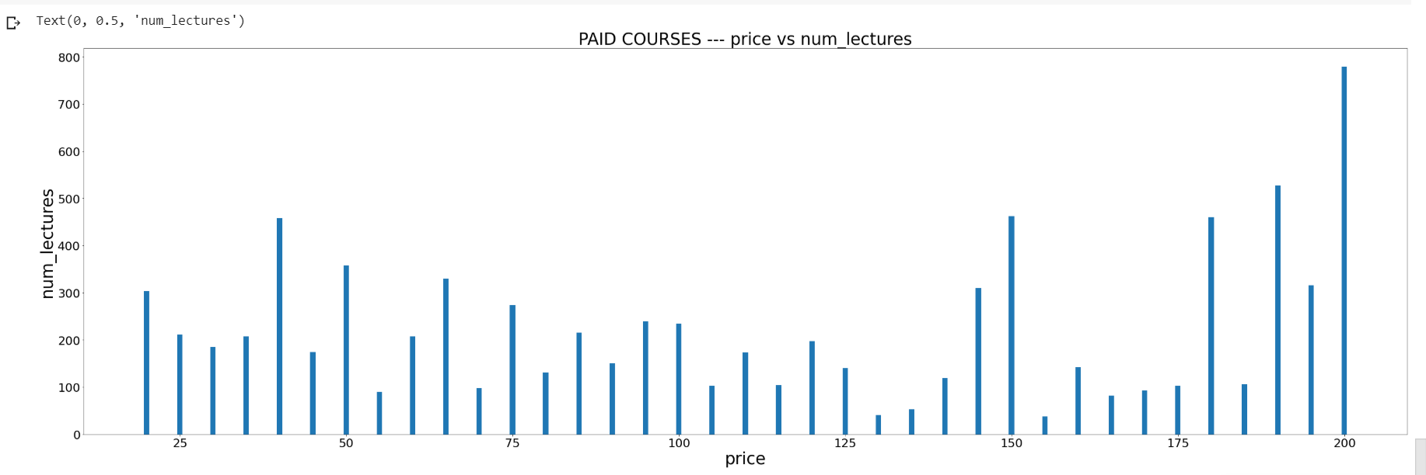
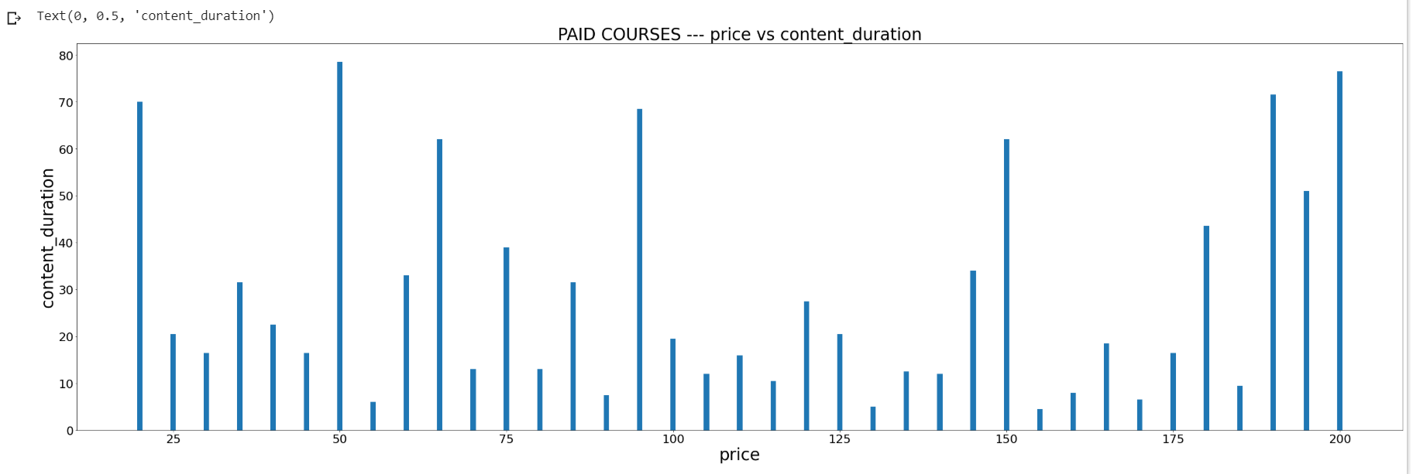
The highest number of lectures are for the highest course price.
The highest content duration is for the course price 50.
Costliest course doesn’t mean more content duration.

Slide 32
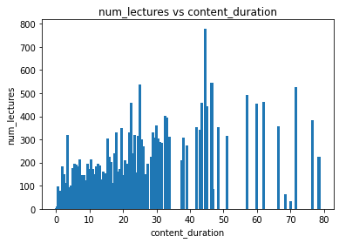
Looking into Course content and Lecture Duration
Most lectures have longer content Duration

Slide 33
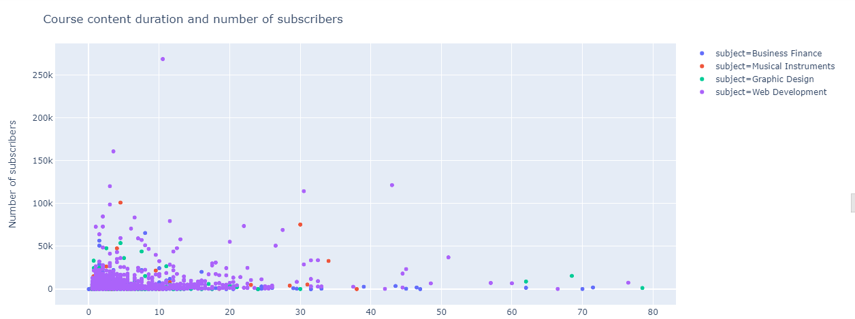
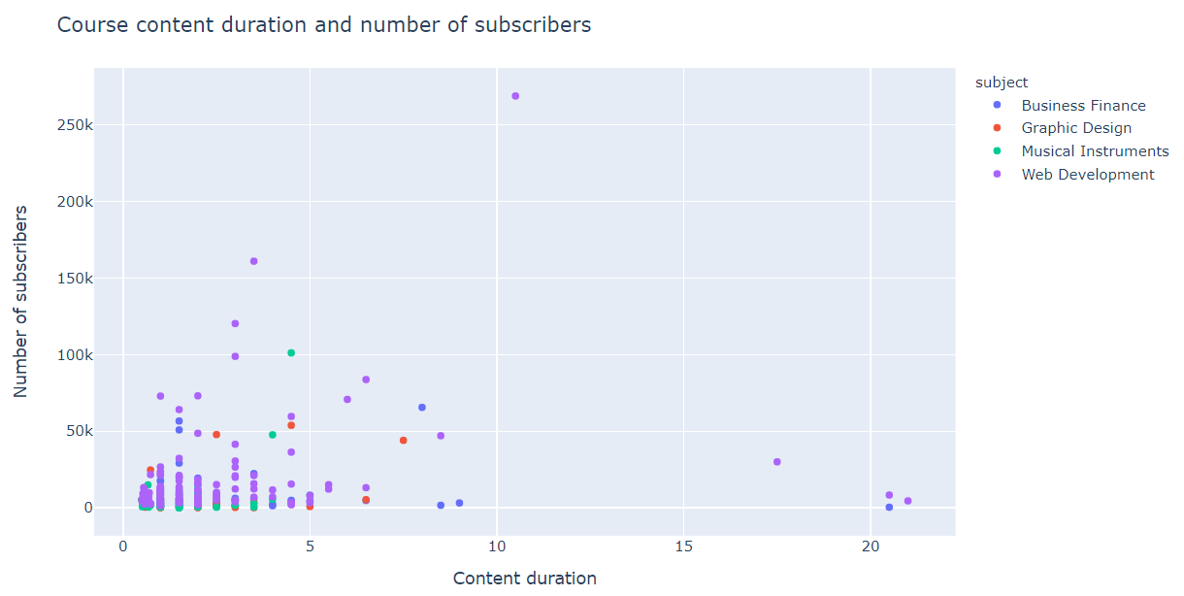
User Duration Preference
Most Users Prefer the courses to have less duration
Free Courses has less content duration

Slide 34
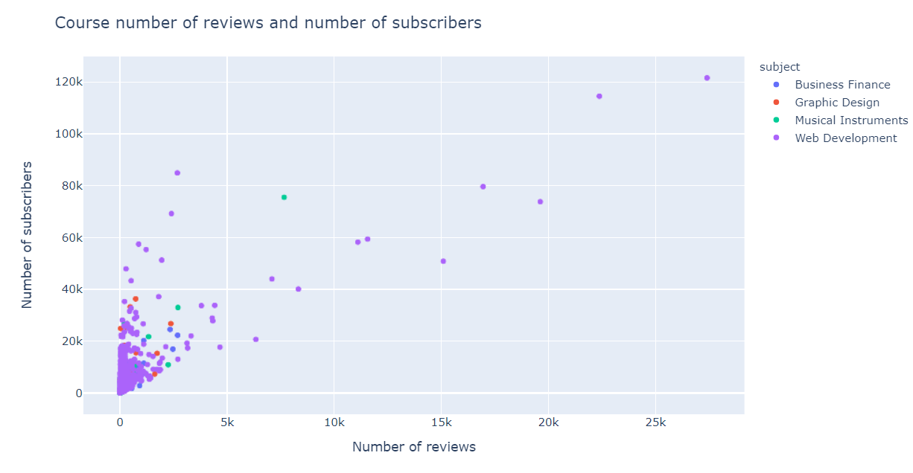
User importance over Review
Paid Courses have a higher concentration of reviews

Slide 35
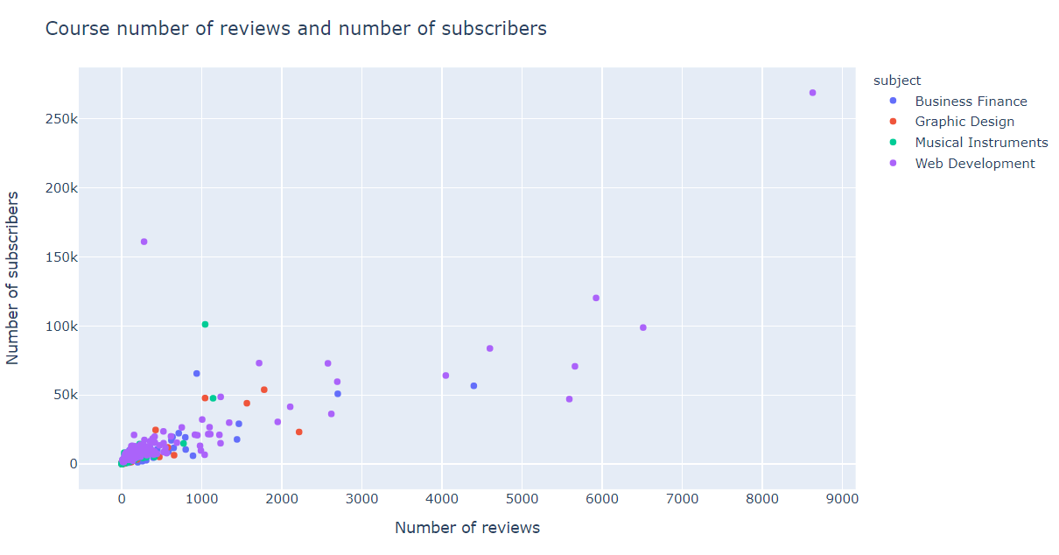
User importance over Review
Users care less about reviews when it comes to Free Courses.

Slide 36
POPULAR COURSES:
Initial Observations:
The price of the courses varied from 0 to 200 dollars.
There are courses with zero subscribers
There are courses with zero hour content
Number of reviews are way lesser than the subscribers.

Slide 37
The Number of subscribers are more for Web Development Courses
The number of reviews is the highest in Web Development.
Remaining courses are ranged in between 1000 to 2000 for both subscribers and reviews

Slide 38
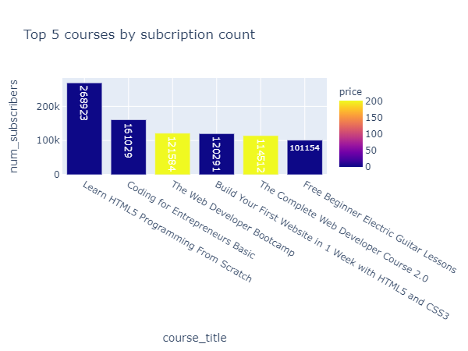
The top 5
The courses with highest subscription count are programming courses (5 out of 6). Out of the top 6 subscribed courses, 4 are free courses and 2 are paid courses(worth 200$).

Slide 39
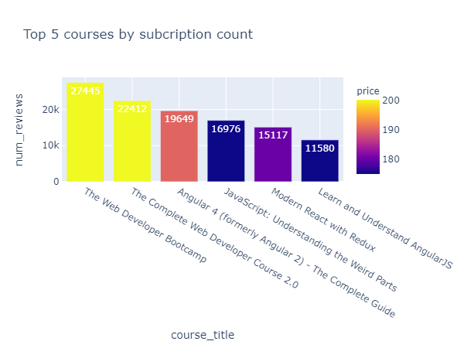
Most reviewed COURSES:
The courses with more reviews are programming courses.
Out of the top 6 reviewed courses, 4 are paid courses and 2 are free courses.
Shows that paid courses have more engagement with the subject.

Slide 40
Top subscribed courses per subject:
By Subscription count, the top 5 courses are programming courses.
The most sought out courses are programming courses.
Some courses from subjects Business Finance, Graphic Design and Musical Instruments have zero subscribers but Web Development did not have any zero subscribed courses indicating the interest/demand for Web Development
The cost of top subscribed paid courses is 200$ from web development subject. It was also observed that paid courses have more engagement (in terms of reviews) when compared to free courses.

Slide 41
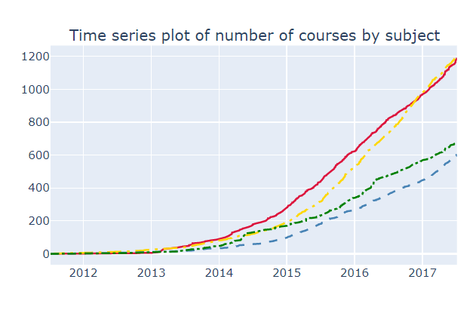

The increase in no. of Courses

Slide 42
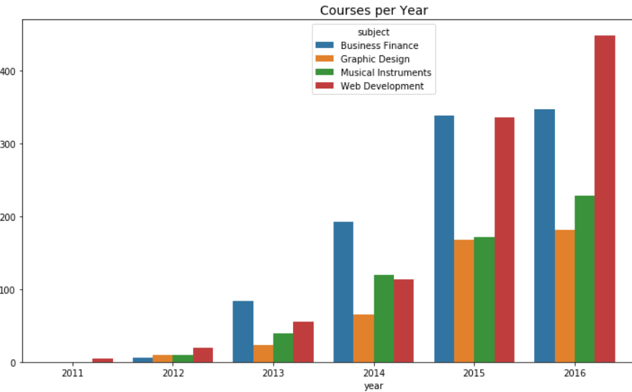
The amount of Web Development courses being upload has taken a huge leap in the year 2015.
Web Development became the most uploaded course in 2016 surpassing Business Finance.
Web seems to a slight decline in 2014

Slide 43
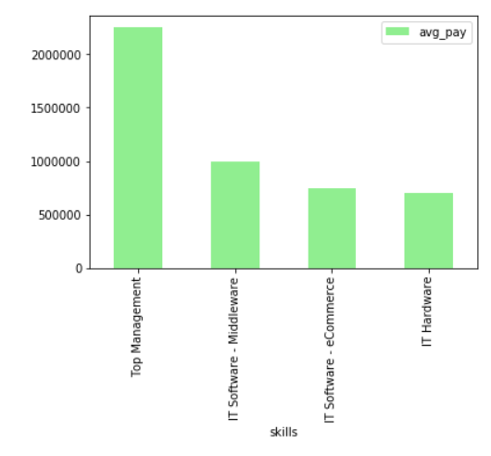
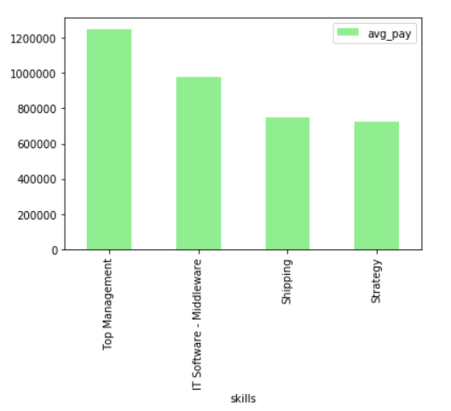
2015
Average Salary (Naukri Job posting) per skill
2016

Slide 44
Average Salary (Naukri Job posting) per skill
We notice that the average salary on Top Management which usually takes care business has reduced.
IT sector has shown a steady growth between the years.

Slide 45
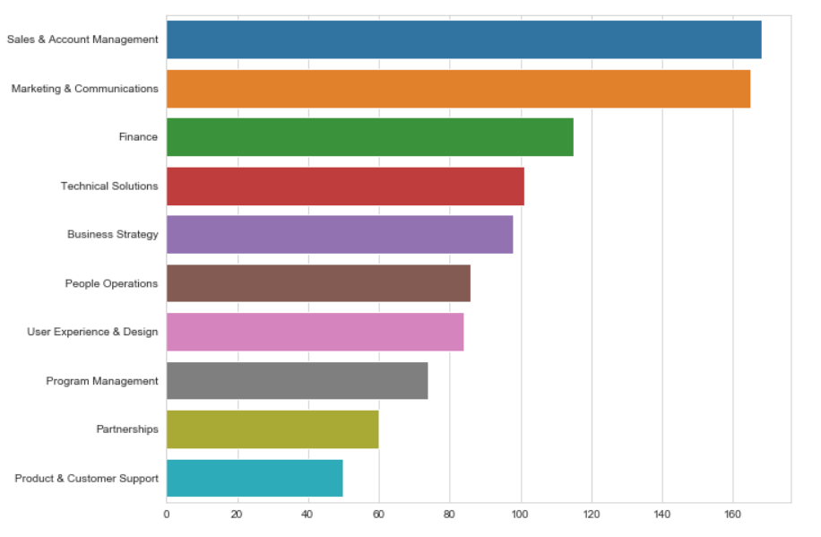
Google job skill Dataset
We observe that there is higher demand for financial skill set. This explains the higher concentration of Business Finance courses.
There is a high requirement for Business Finance skills and Technical skill set(Web dev). This explains the user subscription pattern.

Slide 46

Godaddy
According to GoDaddy’s survey and article :
Web developers and designers have always been the bedrock of company internet strategy, and their services are more essential than ever, as web technology hits another innovation sprint. A new study commissioned by GoDaddy says this Golden Age of web development and design, signaling new small business growth and an economic boost, shows no sign of slowing down.
It’s fueled largely by continued growth in the retail and travel industries — and professionals are eager to find new ways to keep up with growing demand and evolving technology.

Slide 47

Godaddy
Web development and Business have to work hand in hand because of the growing the Digital Economy
We observe that for the professional to keep up with the evolving trend and for developers to Improve their skillset Online Training courses are advised.
This shows us the reason for increase in online courses of Business Finance and Web Development

Slide 48
Tech City UK website
According to the article published on the Tech City UK website.
To put employer demand for web development roles in context, in London there was a 45% increase in the number of Web Design and Development Professionals from 2015/16 to 2016/17 according to the Office for National Statistics’ (ONS) Labour Force Survey (LFS)2. This occupation relies heavily on programming languages like Javascript3, and HTML – reinforcing the correlation between the high demand for programming languages like Javascript, and the region’s burgeoning digital tech labour force. Web development jobs are picking up from a post-recession low Although not quite back up to the heady heights of pre-recession numbers, London web development jobs are back on the up. From 2013 to 2014 we see a significant downturn in web development numbers in the London and the South East – from Figure 1, these regions were arguably hardest hit in absolute terms. London, for example, experienced a reduction in web development jobs of 47% from 16,200 in 2012/13 to 8,600 in 2013/14.

Slide 49
Tech City UK website
The gist is:
In London there was a 45% increase in the number of Web Design and Development Professionals from 2015/16 to 2016/17.
Occupation relies heavily on programming languages like Javascript3, and HTML. This also explains our User preference on Top courses .
London experienced a reduction in web development jobs of 47% 2012/13 to 2013/14. This explains why less courses got uploaded in 2014 on Web Development

Slide 50
User’s have high preference for Web Development courses.
Job skill requirements have Business Finance as an important skill set. This explains the high concentration of Business Finance courses
According to our observation Users tend to avoid Business Finance courses.
This could lead to skill gap when it comes to job skill requirements.

Slide 51
Thank You!

